Slide 1
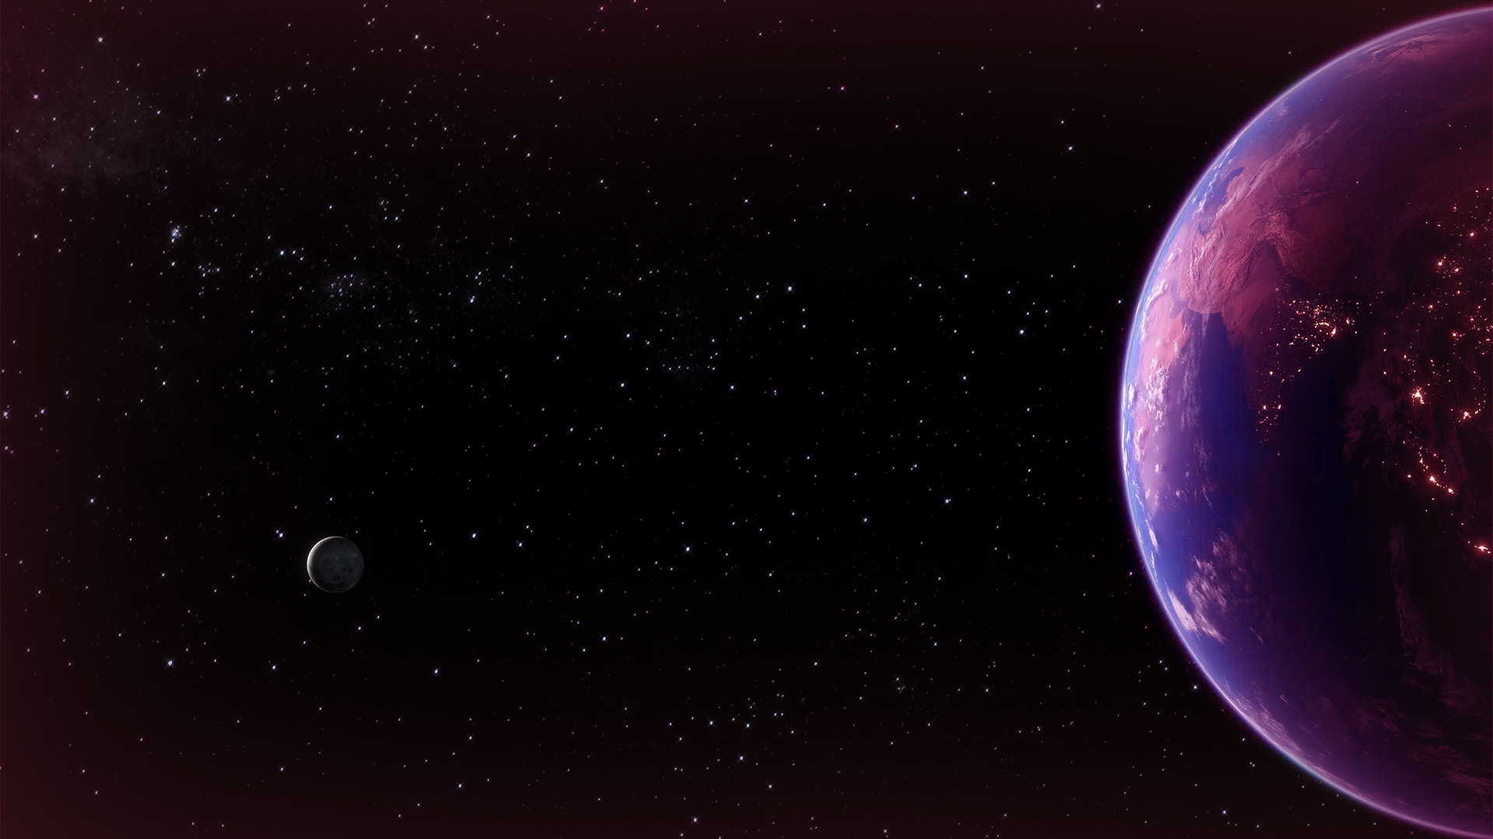

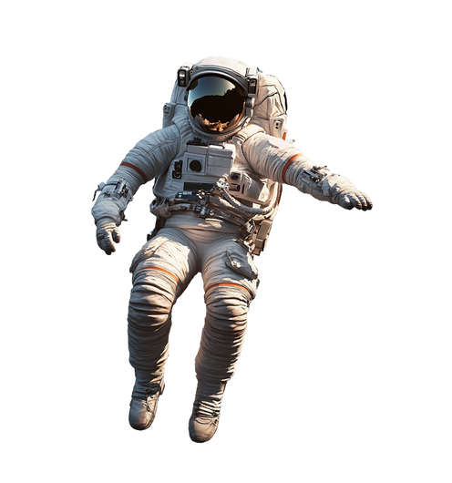
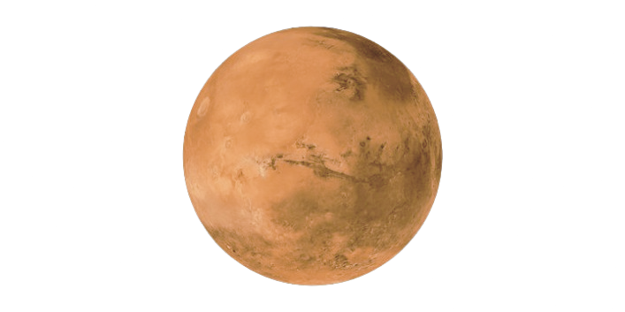
Mangal Mandli
Team Leader: Saksham Gupta
Problem Statement
College: IIT Guwahati
Dual image super resolution for high-resolution optical satellite imagery and its Blind Evaluation

Slide 2
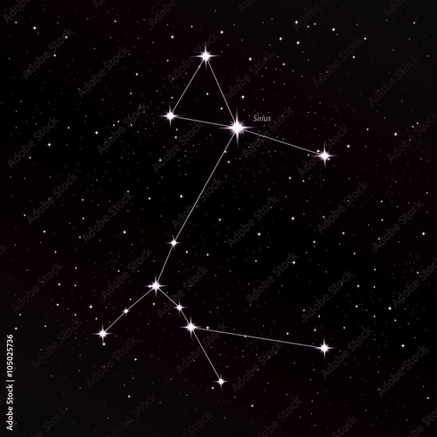
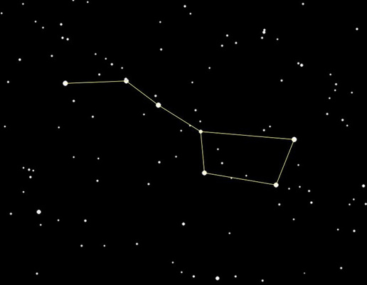
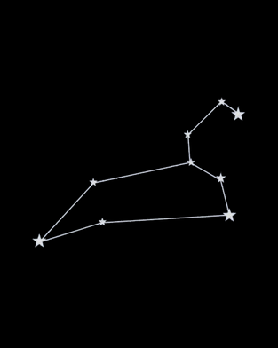

Saksham Gupta
Yashvi Mehta
Mangal Mandli
Govind Akash Sanghani
Nalin Goel

Slide 3









What are the actual problems?
Satellite Imaging Constraints:
Why Multiple Low-Resolution Images can Replace High-Resolution Ground-Truth
Limitations of Standard Quality Metrics:
The Ground-Truth Problem in Real-World Deployments
{
-
Cost Efficiency
Overcoming Reference Limitations
Enhanced Image Quality
How is the Solution helping?
PS Explainer
RADIAN Architecture
Differences
Training Pipeline
Tools & Results
Degradation
Blind Eval Arch.
Blind Eval Correlation
Scalablity

Slide 4
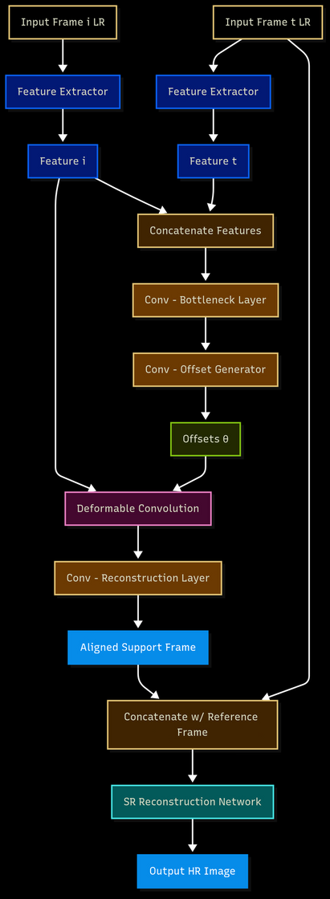
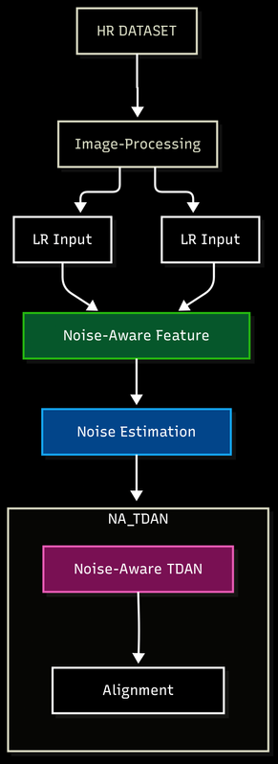
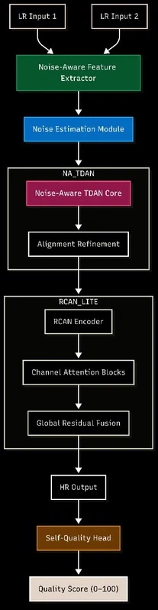
TDAN Architecture
RADIAN Architecture (TDAN)
RADIAN uses two adjacent low-res satellite frames to learn richer spatiotemporal features. Training data are made from high-res imagery by adding Gaussian blur, sensor MTF noise, and calibrated sub-pixel shifts to mimic orbital degradations. A Noise-Aware Feature Extractor jointly encodes both inputs, while a Noise Estimation Module predicts a per-pixel noise map. This map guides a Noise-Aware TDAN that modulates deformable offsets for robust alignment under spatially varying noise, followed by an Alignment Refinement unit to enforce smooth, reliable correspondences.
PS Explainer
RADIAN Architecture
Differences
Training Pipeline
Tools & Results
Degradation
Blind Eval Arch.
Blind Eval Correlation
Scalablity

Slide 5
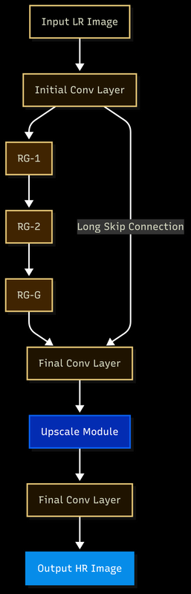
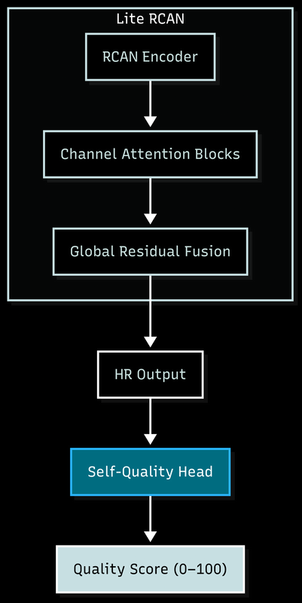
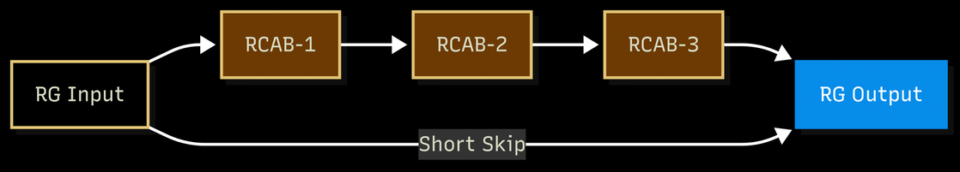
RCAN Architecture
RADIAN Architecture (RCAN)
Post-alignment, a Lite RCAN (memory-efficient RCAN) extracts deep features, recalibrates them via Channel Attention Blocks, and fuses context with Global Residual Fusion, yielding strong features for super-resolution and perceptual quality; deformable alignment plus attention preserves structure and resists degradation.
Residual Group Architecture
PS Explainer
RADIAN Architecture
Differences
Training Pipeline
Tools & Results
Degradation
Blind Eval Arch.
Blind Eval Correlation
Scalablity

Slide 6





How different is it from any other existing ideas?
Models | SwinIR (Swin Transformer for Image Restoration) | STFAN (Spatio-Temporal Feature Aggregation Network) | RADIAN (Our Proposed Model) (Residual Aligned Deformable Image Attention Network)
Input Type | Single Image (SISR) | Multi-Frame (>5) video-like stacks | Dual Low-Resolution Frames (Shifted/Noisy)
Noise Handling | No explicit denoising; sensitive to artifacts | Assumes pre-cleaned data | Explicit Noise-Aware Module + Estimation
Alignment Method | No alignment (single input) | Optical flow + attention aggregation | TDAN-style deformable alignment + refinement
Edge Preservation | Strong due to attention, but risks hallucinations | Partial Via temporal fusion | Channel Attention Blocks (RCAN) + Edge Loss
Sensor Shift | Fails under misaligned conditions | Needs high frame overlap | Handles sub-pixel motion + noise
Inference Efficiency | Slower; needs >8GB VRAM for good performance | Demands high memory & time | Efficient on T4 GPU
RADIAN differs by explicitly addressing the two key challenges in satellite MISR: misalignment and realistic noise. Unlike STFAN, which requires many clean frames, and SwinIR, which only handles single-image inputs, our model aligns two noisy frames using deformable convolutions and enhances detail via channel attention. It’s lightweight, robust to sensor degradation, and even supports blind quality estimation, making it ideal for real-world deployment.
PS Explainer
RADIAN Architecture
Differences
Training Pipeline
Tools & Results
Degradation
Blind Eval Arch.
Blind Eval Correlation
Scalablity

Slide 7
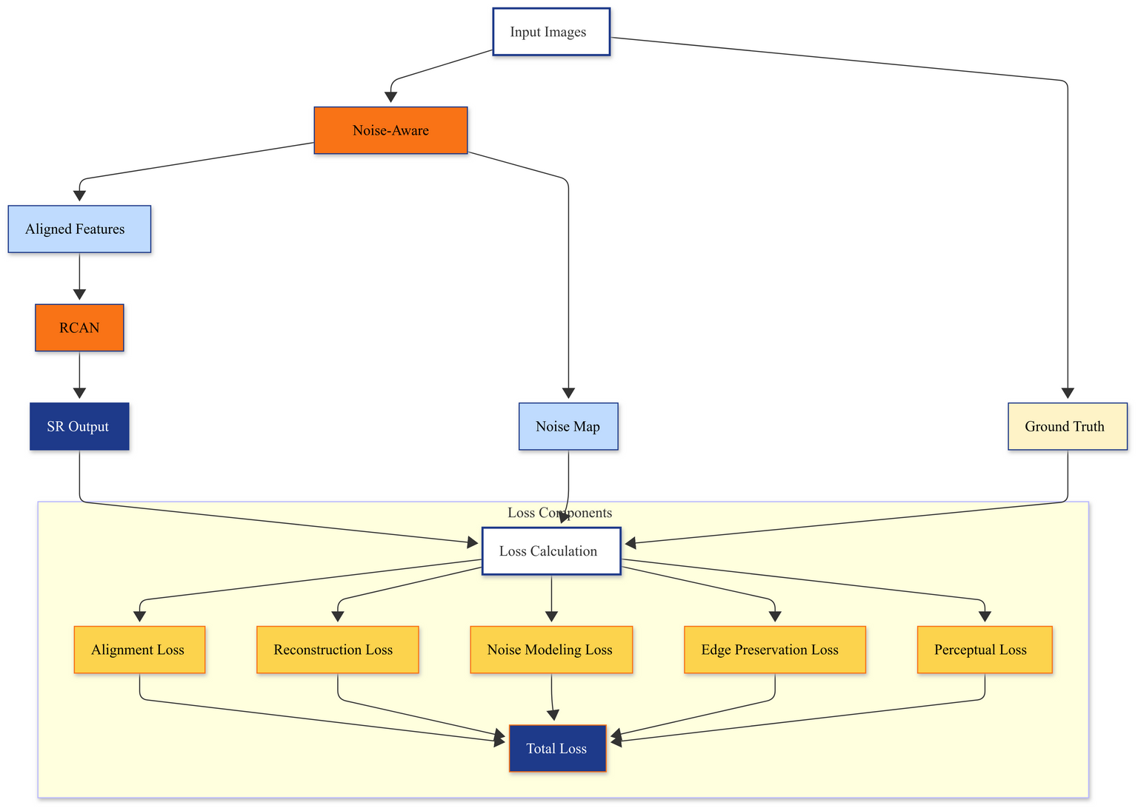
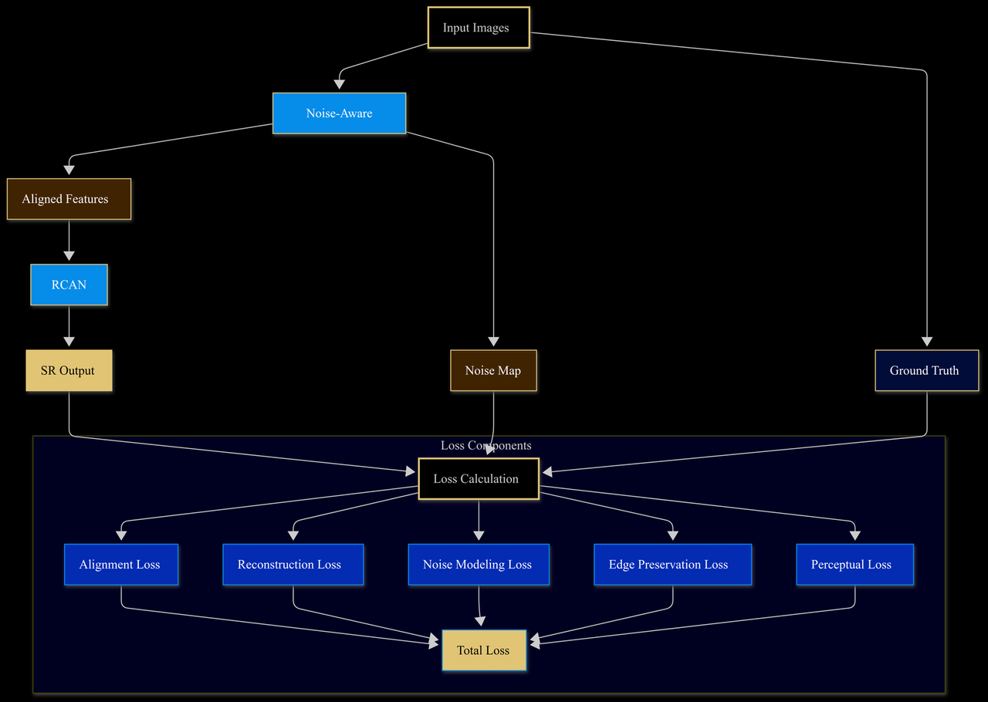
Loss Function
The proposed loss framework supervises a dual-image super-resolution model under real-world noise and degradation. It integrates a Noise Map, estimated from inputs, to modulate both alignment (via Noise-Aware TDAN) and reconstruction (via Lite RCAN). The system computes a Total Loss composed of five parts:
Alignment Loss ensures temporal consistency,
Reconstruction Loss maintains pixel fidelity,
Noise Modeling Loss aligns with estimated noise,
Edge Preservation Loss retains sharp structures,
Perceptual Loss enhances visual realism.
Together, these losses guide the model to produce high-resolution, perceptually consistent outputs even under challenging degradation scenarios.
Loss Computation Pipeline
PS Explainer
RADIAN Architecture
Differences
Training Pipeline
Tools & Results
Degradation
Blind Eval Arch.
Blind Eval Correlation
Scalablity

Slide 8
Tools/Technology & Performance Metrics Used:
Developed in PyTorch, leveraging Deformable CNNs for alignment and Residual Channel Attention Blocks for feature refinement. Preprocessing used OpenCV and PIL for geometric normalization and band alignment. Matplotlib is used for visiualization and tqdm for logging. Evaluated with PSNR, SSIM, LPIPS (perceptual quality), BRISQUE (no-reference), NIQE (Natural Image Quality Indicator). Implemented custom residual blocks with skip connections to enhance gradient flow. Deployed on GPU clusters for training, with results validated against SpaceNet benchmarks. The pipeline integrates physics-based degradation models for synthetic training data and supports TensorRT for optimized inference.
PS Explainer
RADIAN Architecture
Differences
Training Pipeline
Tools & Results
Degradation
Blind Eval Arch.
Blind Eval Correlation
Scalablity

Slide 9
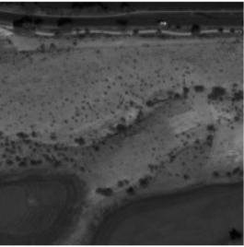
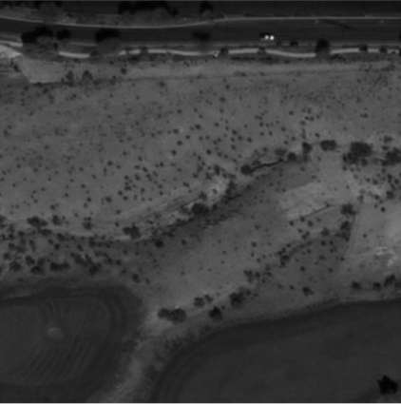
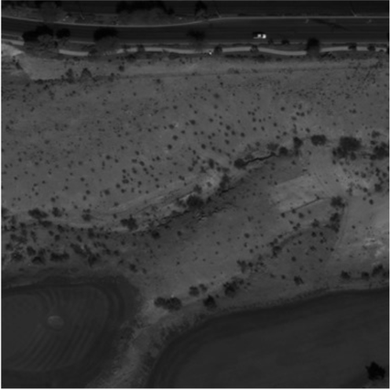
RADIAN Results
PSNR: 32.89 dB, SSIM: 0.9361, LPIPS: 0.1404
LR1
SR Output
Ground Truth
the diagonal erosion channel running from center-left toward the lower-right shows sharper micro-texture and discrete shrub dots in SR and Ground Truth, while LR blurs them.
Zoom to the top band: the thin, bright linear feature near the very top (likely a road/edge) appears crisp and continuous in SR and Ground Truth but smeared in LR.
Lower-left water edge: along the curved shoreline, SR and Ground Truth show a tighter, well-defined boundary; LR shows a soft, thicker boundary.
Overall Results: Avg PSNR: 31.1004; Avg SSIM:0.9076; Avg LPIPS:0.0701
PS Explainer
RADIAN Architecture
Differences
Training Pipeline
Tools & Results
Degradation
Blind Eval Arch.
Blind Eval Correlation
Scalablity

Slide 10
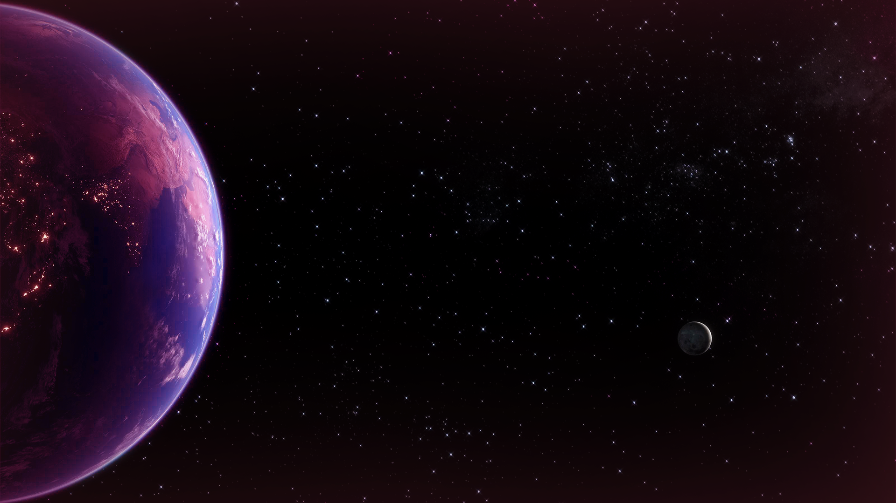
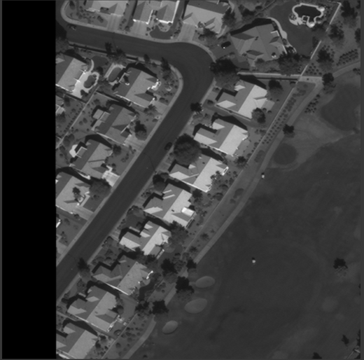
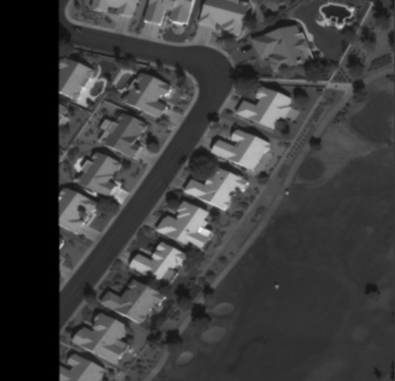


Why Blind Evaluation
We have a working super-resolution (SR) image generator evaluated with full-reference metrics like SSIM and PSNR. To deploy it in real-world scenarios where ground-truth images aren’t available, we now need a blind (no-reference) method to assess and score SR image quality.
Degradation
Since no ground-truth or curated training set exists for blind (no-reference) SR quality evaluation, we will synthesize realistic training data by adopting Zhang et al.’s practical degradation model to train our blind evaluation architecture. The model randomly shuffles blur, downsampling, and jitter operations to better mimic real-world degradations, including isotropic/anisotropic Gaussian blur, nearest/bilinear/bicubic/down-up sampling and jitter(pixel shift). Randomly shuffling the degradation order and sampling intensities is crucial because it vastly enlarges the degradation space, making SR models more robust to real-world combinations where blur, downsampling, and noise appear in varied sequences and strengths.
Ground Truth
Low Degradation
medium Degradation
High Degradation
PS Explainer
RADIAN Architecture
Differences
Training Pipeline
Tools & Results
Degradation
Blind Eval Arch.
Blind Eval Correlation
Scalablity

Slide 11
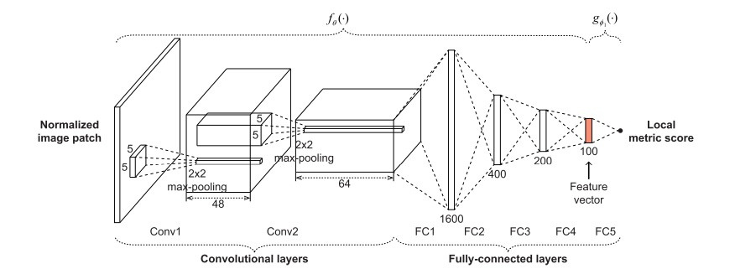
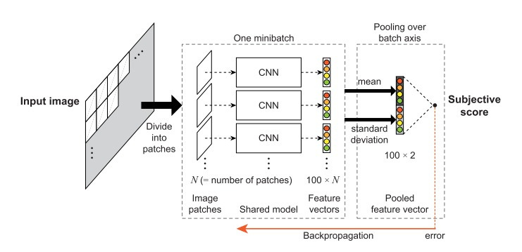
Blind Evaluation Architecture
O
PS Explainer
RADIAN Architecture
Differences
Training Pipeline
Tools & Results
Degradation
Blind Eval Arch.
Blind Eval Correlation
Scalablity

Slide 12
Scalablity
Scalability
Compute: Dual-image SR is lighter than multi-frame SR; can be pruned/quantized for cloud, edge, or on-orbit use.
Data/ops: Works with just two shifted LR images; runs fleet-wide with blind IQA for automated QA at scale.
Economics: Upscale LR on demand to cut HR tasking, storage, and bandwidth.
Future directions
Policy-driven HR vs SR acquisition.
Lightweight edge/on-orbit SR.
Stronger blind IQA (attention/unsupervised) for robust automation.
Use cases
Urban mapping, change detection.
Agriculture (boundaries, stress).
Disaster response, environment.
Security/situational awareness.
Cost-effective archives: store LR, upscale when needed.
PS Explainer
RADIAN Architecture
Differences
Training Pipeline
Tools & Results
Degradation
Blind Eval Arch.
Blind Eval Correlation
Scalablity

Slide 13


